Slide 1
Training Material
Authors: Eleni Preza & Catherine Christodoulopoulou CTI

Slide 2
Contents
1. Introduction
2. SONET-BULL Platform
Members
Registration
Login
My profile/my account
My social network
Groups
LO’s (Forum, Wiki, Repository, Case study, Bullying episode, Educational Activity, Survey, Anti-Bullying Policy )
Browsing LO’s
My Dashboard
Tests
Privacy & Anonymity of the Data

Slide 3
1. Introduction
SONETBULL project aims at the creation of a platform through which members of school community will be trained and train others in methods, strategies dealing with bullying. In particular, users will have access to accredited training material, and will be able to create learning objects and artefacts that will be available to other users for commenting, discussing or contributing on that.
To realize this platform’s function, the project intends to combine the modern pedagogical approaches of e-learning and peer learning, which are suitable for adult learners too.

Slide 4
2. SONET-BULL platform

Slide 5
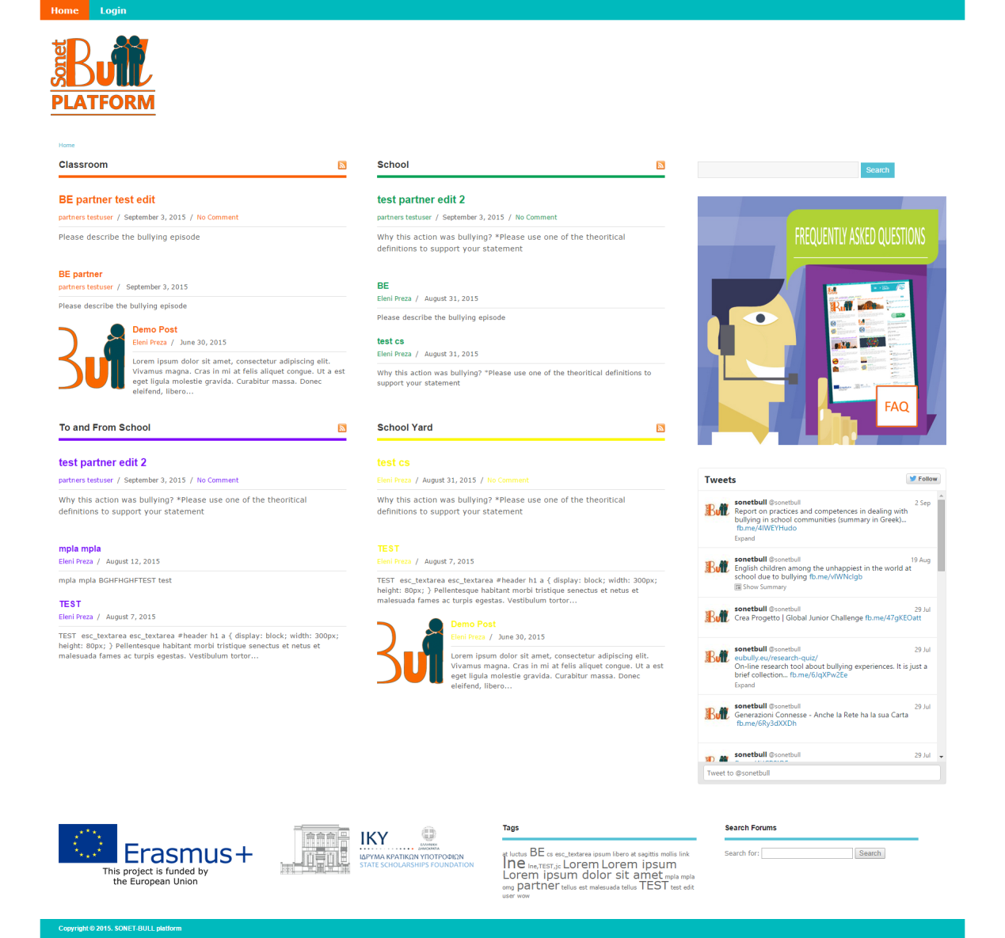
An introduction to SONET-BULL Platform for members.
Home Page

Slide 6
Registration
The register page contains the registration form and is the users can register on the SONET-BULL platform. The registration form includes the following fields: username, first name, last name, Gender, Associated School or Organization, Account Type, username, e-mail address, password (with confirm password turned on).

Slide 7
steps of registration
Click on the “Register” button on the Home Page.
Fill in the form.
Click on the “Register” button at the bottom of the form.
Check Your Email To Activate Your Account! You have successfully created your account. To begin using the SONET-BULL platform you will need to activate your account via the email we have just sent to your address.
Wait for a minute or so if you don’t see the email to activate your account. If the activation email doesn’t show up in your inbox, check your “Spam” folder just in case it was redirected by your email client.
Click on the activation link in the email. This will bring you to the homepage of the site.
Fill up the rest of your profile information if you only completed the “required” fields during registration, via the “My Profile” page . Or, begin exploring “My Social Network”, Groups you can join and many more.

Slide 8
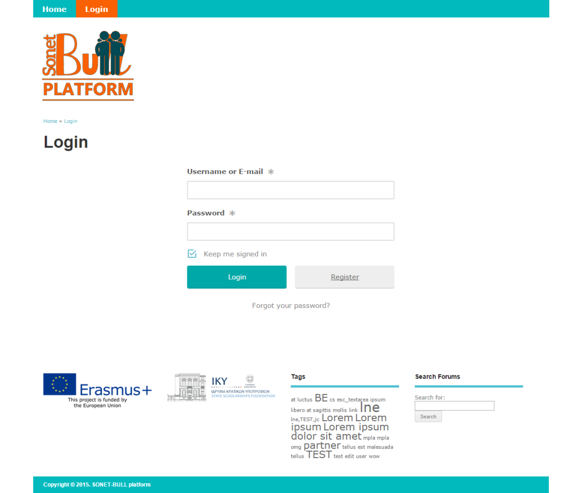
login
The login page contains the login form and is the page users can login to the SONET-BULL platform. The login form includes the fields: username or email and password with the capability of password reset.

Slide 9
My Profile/My account
The “My Profile” page is the page that displays each user’s profile and contains each user’s information.
“My account” is a separate page that contains the account settings for each user.

Slide 10
My Social Network
Here the user can see the activity of all the users in the SONET-BULL platform.

Slide 11
My Social Network → Personal
This page is the record of all the users activities throughout the site listed in chronological order. If you’re logged in, there’s a status update box before the activity stream where you can post what’s on your mind.
Users can Access this page by clicking on the name or profile picture of their account while in “My Social Network”.
For more Details on each tabs functionalities (Notifications, Messages, Groups, Forums, Send Invites, Repository e.t.c.) see the Manual.

Slide 12
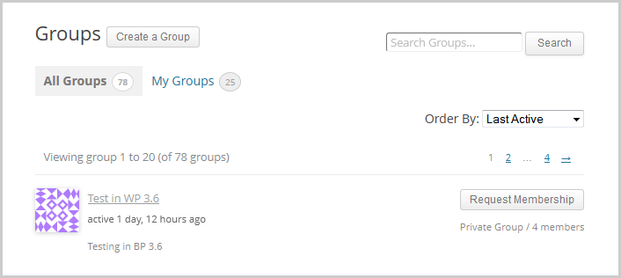
Groups
My Social Network → Personal →
Groups → Memberships
How To Join a Private Group
In your site’s Group Directory page, click on the “Request Membership” button of the Private Group you want to join.
You’ll see the “Request Membership” text in button change to “Membership Requested”.
Your request to join the group is sent to the Private Group’s Admin.
For more information on Groups see the Manual.

Slide 13
My Social Network → Personal → Send Invites
The SONET-BULL platform has the ability, for logged in users to Send Invites to non-Members of the platform in order to join.

Slide 14
Forums
Users have the ability to be a part of the SONET-BULL platforms predefined forums by creating Topics. A Forum gives the opportunity to users to learn by choosing a specific Learners Group to which to pose the question (e.g. Teachers, Parents, School Directors etc.). Through Forum discussion users can put into practice the knowledge gained at the training, both in regards to the theoretical background and via peer learning.
This tool will be found in a devoted section of the platform entitled “Forum”.
For more information on forums see the manual.

Slide 15
Wiki
The users will have the capability to create/upload documents in order to describe bullying terms etc.

Slide 16
repository
Repository serves as an online File Viewer and Manager. All the Uploaded Files are clustered in one page named “Repository”. Its File will have its corresponding tags and will belong in certain Categories.

Slide 17
Case Studies (1/2)
Case studies are typical examples of the kind of knowledge/learning that the project is addressing. It is important for every core/end user to know how to report a case and how to narrate the story in a meaningful way to others.
The reporter of the case may be either one of the actors (teacher, parent, school director) or a member of the wider school community. The reporting of cases should abide by the ethics of reporting without revealing children’s names or school address. As a distinguishing element we use the domain categorization (School, To & From School, Home, Other Places).
Case Studies will be implemented through the usage of a form with predefined fields. This form will be found in a devoted section of the platform entitled “Case Studies”. In this section there will be pre-uploaded case studies (as arisen from O1) serving as examples. The author/ user will have the opportunity to create his/her own case study by filling the predefined fields.
Finally, he/ she can pose questions to future readers/commenters (e.g. “How do you think the school director should have reacted?”). See part of the CASE STUDY form below:

Slide 18
Case Studies (2/2)

Slide 19
Bullying Episode (1/2)
Many teachers/ parents are witnessing bullying episodes in everyday life, in which they do not know how to interfere. With this type of Learning Object the user describes a Bullying Episode to other users. The episode could be real or hypothetical. The aim of this short description of a bullying episode is to be share (by the author) or to be highlighted (by other users) the most suitable technique of dealing with bullying.
Bullying Episodes will be implemented through the usage of a form with predefined fields. This form will be found in a devoted section of the platform entitled “Bullying Episodes”. The form will be shorter and simpler that the one of Case study
See the Bullying Episode form below:

Slide 20
Bullying Episode (2/2)

Slide 21
Educational Activity
Reflects the understanding and deepening at a theoretical subject and at the same time demonstrates user’s transmission skills of this knowledge to others especially to students.
The educational activity refers mostly to users who are teachers, school directors etc., and give the opportunity for anyone who wants to schedule and implement an educational activity in the classroom and assess its results.
The activity aims at teaching in the classroom about bullying (what is it? how you can protect yourself? What others want to do for you?), but not only the traditional method of learning. This activity aims to raise teachers’ creativity and explore the teaching methods through various materials (such as movies, book, role playing etc.).
Educational Activities will be implemented through the usage of a form with predefined fields. This form will be found in a devoted section of the platform entitled “Educational Activity”.
At the end of the activity teachers should assess their findings and should present the results to the others peers, after which other users have to assess and give feedback to the author.

Slide 22
Survey
This LO will be implemented through the usage of “Google Forms” modified and customized so as to serve the purpose of the LO. In particular, users will be able to create their own questionnaires and share them with the rest of the users.
In addition, if the user wants to elaborate on the produced results of the survey, he/she will be able to upload the results provided by “Google Forms” (in a chart etc) and he/she can create a devoted group in where he/she can discuss the results with other platform users. The produced results of the group discussion can be further elaborated through the usage of the Blog tool (for the publication of the research findings)
Google Forms tool (https://www.google.com/forms/about/ , HELP).

Slide 23
Anti-bullying policy
This form will be found in a devoted section of the platform entitled “Anti bullying policy”. In this section there will be a pre-uploaded sample serving as an example.
The user has to take the sample into consideration and then fill the form (the fields of the form will be formulated based on the pending sample)
As a second stage if they so wished, and as part of a further L.O., the results of surveys could be combined by the learners to create community activity and a wider piece of research/knowledge. This part involves the participation of number of learners in comparing and contrasting the results and creating a piece of research and observations from this.

Slide 24
Browsing LOs
The user will have the ability to browse through the uploaded LOs by certain predefined Categories.

Slide 25
My Dashboard (1/2)
This is a devoted section where each user can see his uploaded Los (Bullying Episodes, Case Studies, Educational Activities) with the abilities to edit or delete them.
These buttons will also be available through the single view of the LOs from the Home Page, the Browsing Capability, Search e.t.c. :

Slide 26
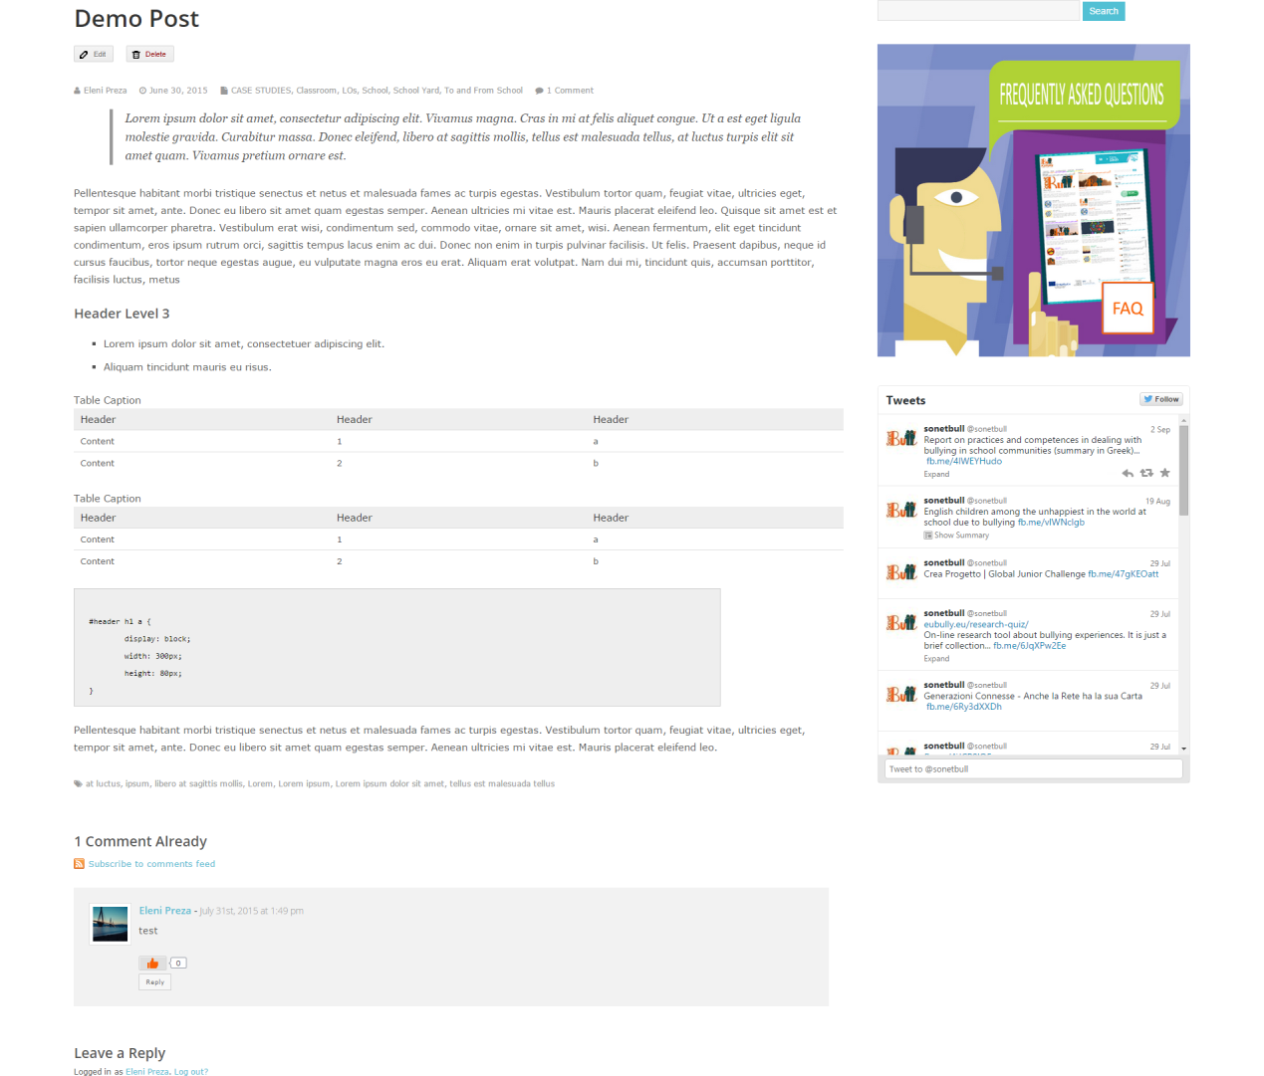
My Dashboard (2/2)

Slide 27
Tests
The following ASSESMENT QUESTIONAIRES for the users to take after they study the corresponding material, will be available through the platform:
Multiple Choice Questions – Trainers Module
Multiple Choice Questions – Universal Module
The user after taking the test will be able to see the immediately results and receive the results by email.

Slide 28
Privacy & Anonymity of the data
Since the project deals with the sensitive issue of school bullying and exploits real life situation the principal rule is the anonymity of the involved person especially the minor.
All persons will be mentioned either by their initials or by alliances.
Furthermore the rules of proper behavior among users (police toward offensive comments, etc) will be determined and included in the Term of Use (TOU) that dominated the platform’s members

